Slide 1
Who’s Home
Michael Blake, Caleb Kauffman, Patrick Caruana, Cris Laney

Slide 2

What is Who’s Home?
Mobile application
Communication/organization application for roommates
Simple way to manage a household
Encourages cooperation

Slide 3
User Accounts
Individual login information
Manage notifications
Join one or more groups
Saves settings/group memberships

Slide 4
Groups
Represents house, club, business, etc.
Contains:
Message board
Bill history
Lists
Location statuses

Slide 5
Core Components
Wi-Fi location reporting
Message board
Lists
Bill Tracking
Notifications

Slide 6

Wi-Fi Location Reporting
Users choose “hotspots”
Only specified locations are shared
Allows privacy
Personal and group notification
Optional
Example “Notify me when someone is at the store”

Slide 7

Message Board
Users can post and respond
Simple form of communication
Intended for announcements (not messaging)

Slide 8
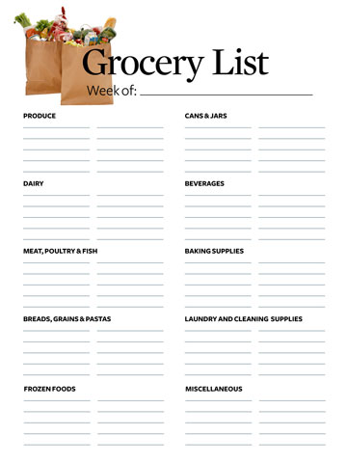
Lists
Simple checklist
Created and edited by users
Useful for groceries, chores, packing for trips, etc.

Slide 9
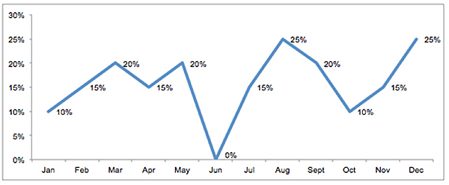
Bill Tracking
No user transaction
Record bill history
Graph costs over time

Slide 10
Notifications
Alerts for location, lists, messages, bills
Customizable
Examples:
Receive a reminder when your roommate posts a bill
Notify me when somebody is at the school
!

Slide 11
Technologies
Client side: mobile application
Android
C# Development in Xamarin
Server side: SQL

Slide 12
Development Tools
Jira: manage progress on project
Visual Studio/Xamarin: application development
Server
Home server or rented server
Mongo/SQL

